Slide 1

Optical Flats
Saharsa College of Engineering, Saharsa
Presented By:
Rupak Kumar
Reg. No: 20102132901
Branch : Mechanical Engg.
Semester: 6th

Slide 2
OPTICAL FLATS
Table of Contents : -
What is Optical Flats
Construction
Working Principle
Applications
Precautions of Use

Slide 3
What is Optical Flats…
Optical flats can be described as an optical grade glass, which is polished and made extremely flat on both surfaces.
They are used for determining the flatness of various optical surfaces.
Optical flats determine the flatness of surfaces by interference.
Optical flats are usually disc shaped with parallel, or nearly parallel, surfaces
Materials used for optical flats need to have a very small coefficient of thermal expansion.

Slide 4
Construction..
Most optical flats are made out of quartz.
Some optical flats are made out of glass.
Optical flats made of quarts are often coated on one side, to give higher reflectivity.
Optical flats are in the shape of discs, having parallel surfaces.

Slide 5
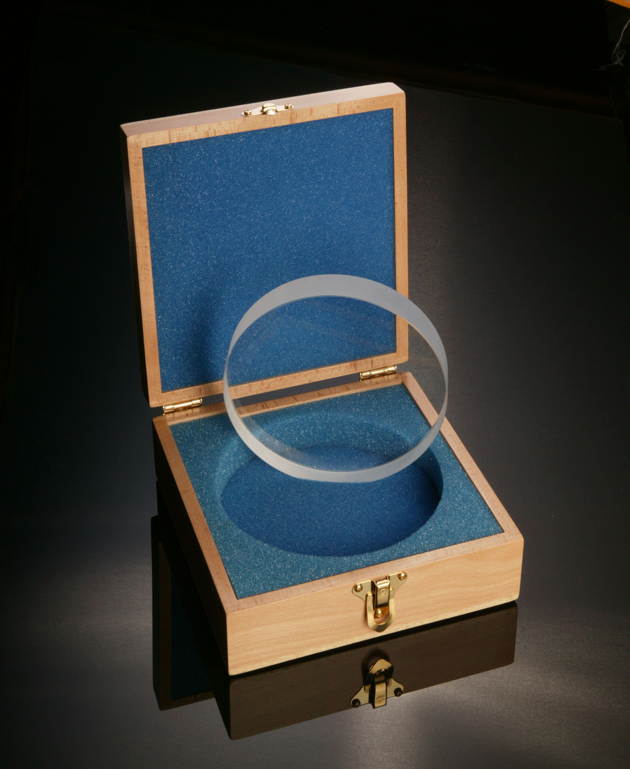
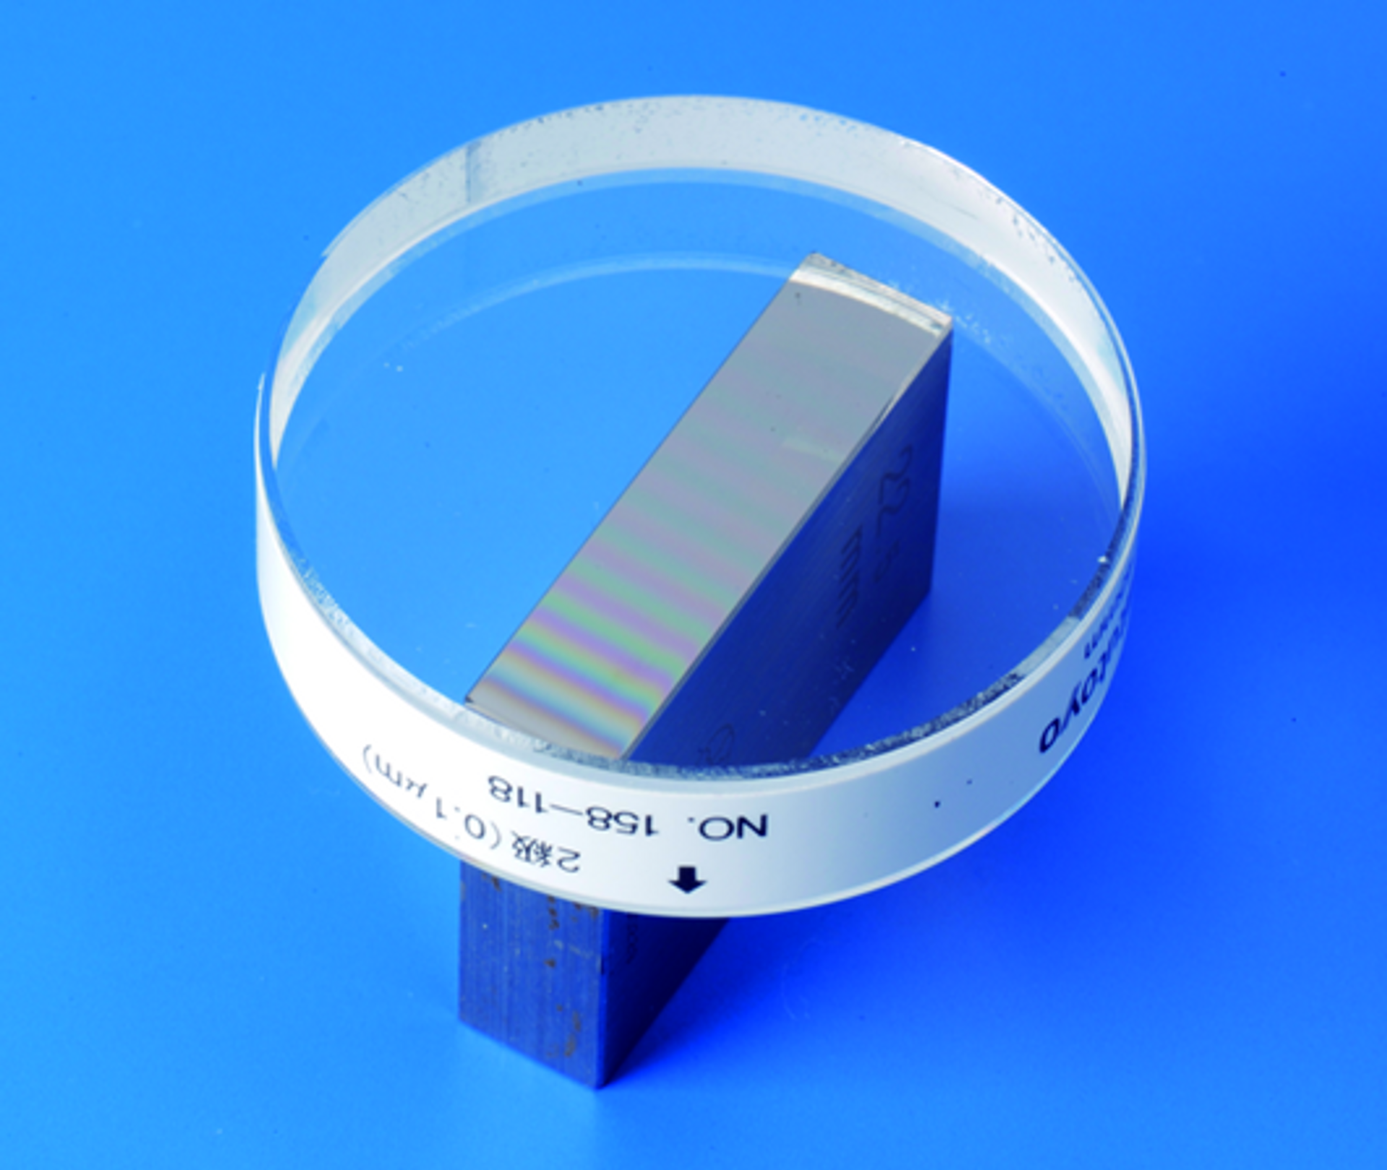
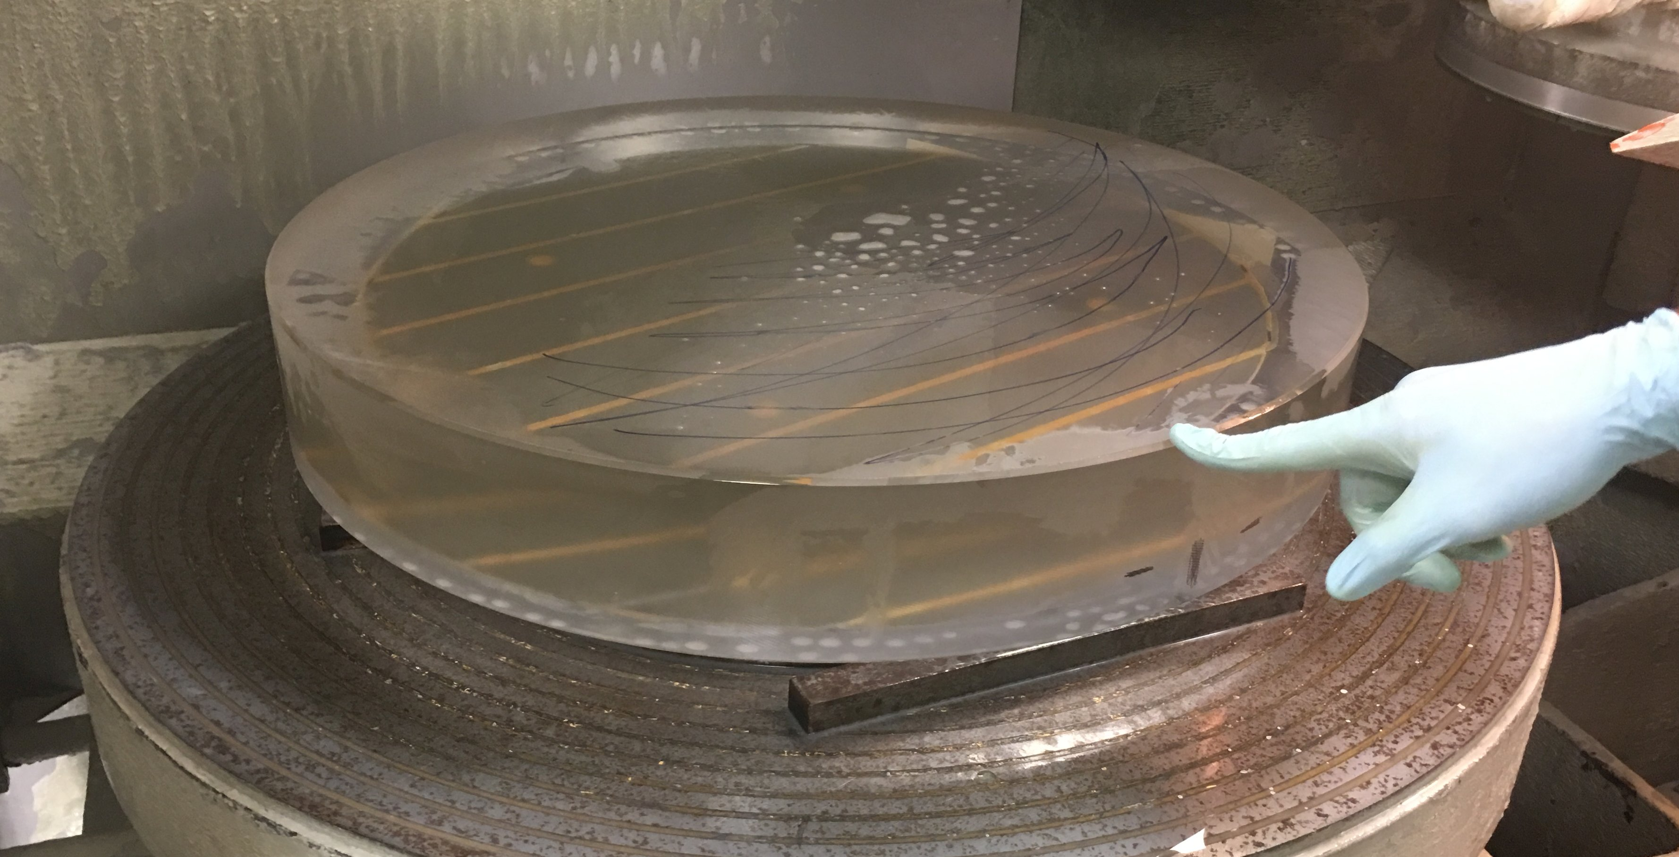
OPTICAL FLATS
Parallel Surfaces
Flat surface

Slide 6
Working Principle
Interference of light is the principle behind the working of optical flats.
An optical flat is placed on a surface , in order to measure its flatness, before a monochromatic light is made to pass through the area of contact.
In cases where the test surface is perfectly flat, there will be no gap between the two surfaces.
In case where the test surface is not flat, interference fringes will be formed, and will be visible in the form of dark and light bands.
The elevation of the surface is determined by counting the fringe differences.

Slide 7
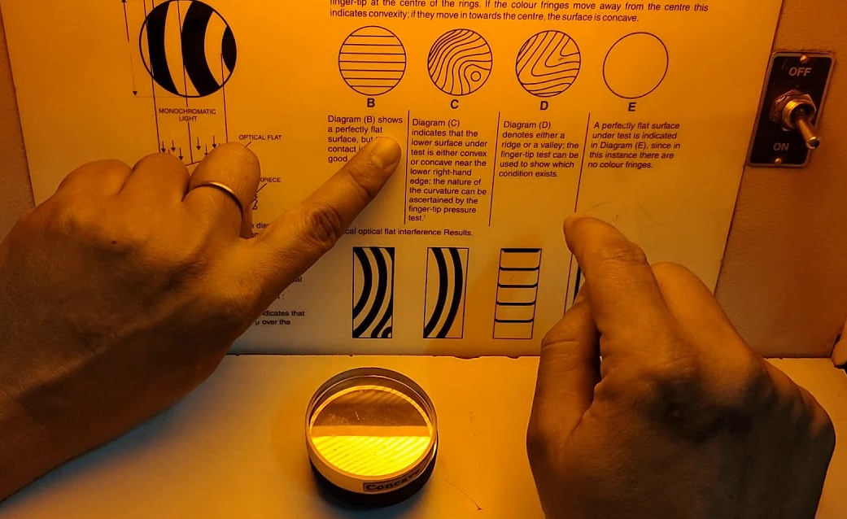
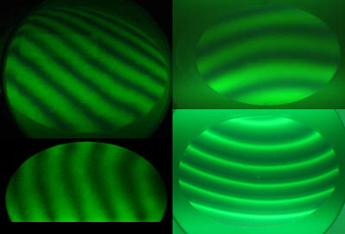
Different types of fringe and its meaning…

Slide 8
Applications
Calibration of flatness of various optical surfaces.
Inspection of gauge blocks.
Testing of filters, mirrors and prisms.
Calibration of laser crystal surfaces.

Slide 9
Precautions of Use
Before using, it should be ensured that the workpiece and flat are clean and free from dirt, dust and oil.
Do not slide the optical flat around on the surface as this may scratch the flat.
The bands should be viewed from a distance of at least 10 times the diameter of the optical flat.
Line of vision must be as nearly perpendicular to the flat as possible.

Slide 10
Thank you !

